Slide 1
Behavioural Design Patterns:
Null Object
Sanketh B Prabhu

Slide 2
Null Object
It is used to encapsulate the absence of an object by providing a substitutable alternative that offers suitable default do nothing behavior
Given that an object reference may be optionally null, the absence of an object can be difficult to treat transparently
Null Object will be used where the null value is to be checked
Courtesy: https://sourcemaking.com/design_patterns/null_object

Slide 3
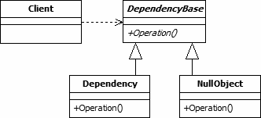
Null Object(Contd.)
This is achieved by using instances of a concrete class that implements a known interface, instead of null references
Abstract class- specifies various operations to be done
Concrete classes- extends the abstract class
Courtesy: https://www.geeksforgeeks.org/null-object-design-pattern/

Slide 4
Null Object Applicability
When an object requires a collaborator.
When some collaborator instances should do nothing
When handling of null has to be abstracted away from the client
Courtesy: https://sourcemaking.com/design_patterns/null_object

Slide 5
Null Object Advantages and Disadvantages
Advantages | Disadvantages
It defines class hierarchies consisting of real objects and null objects | It Can be difficult to implement if various clients do not agree on how the null object should do nothing as when your AbstractObject interface is not well defined
It makes the client code simple | Can necessitate creating a new NullObject class for every new AbstractObject class
Reduction of coupling between various components of a program
Easy reusability of individual components
Courtesy: https://www.geeksforgeeks.org/null-object-design-pattern/

Slide 6
References
[1] https://refactoring.guru/design-patterns
[2] https://sourcemaking.com/design_patterns
[3] https://www.geeksforgeeks.org/

Slide 7
Thank You.

